Slide 1


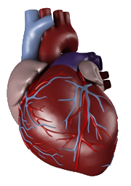
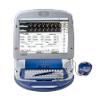

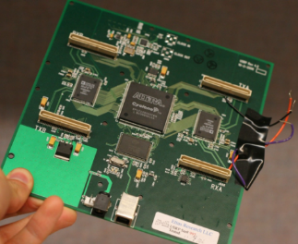
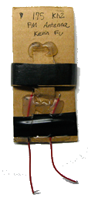

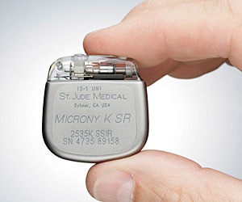
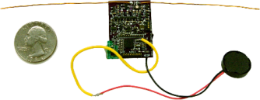
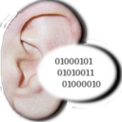
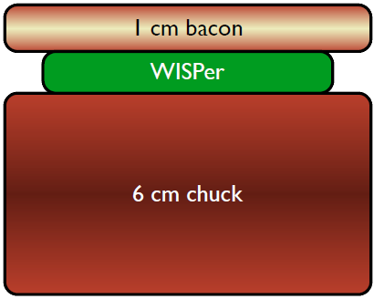


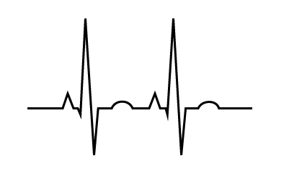
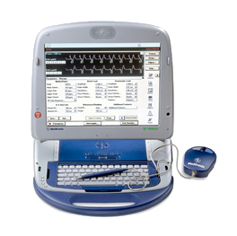
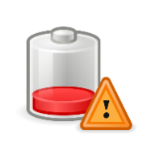
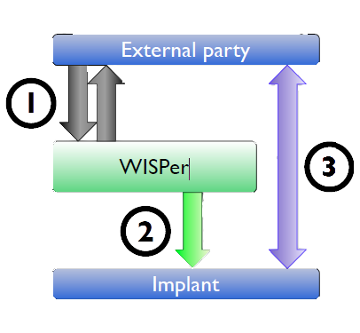

Pacemakers and Implantable Cardiac Defibrillators: Are they really secure ?
Attacks
Defense
Steal a Device Programmer
Build your own Device Programmer !
Eavesdropping on private Information
Sniff Vital Signs
Drain energy
Solutions ?
Authenticate device programmers ?
Encryption ? Passwords ?
Problems
Need emergency access !
Patient’s health : top priority
Prototypes defenses VS some of the attacks
Idea : defend without using battery
External parties pays for power
Need for Reverse Engineering, Modifications
Easy to get root mode
Problem : difficult to set up
Antenna
regulate
USRP board
~10 cm
ICD
The WISP
Total cost : 800 $
Example of prototype : WISP = RFID + computation
WISPer = WISP + code
What kind ? => Implanting physician, Diagnosis, Hospital,
Device state, patient name, date of birth, serial N°, etc...
The future holds some promises : devices more sophisticated
ergo a lot more data to be divulged ?
Experimentation : acoustic notification for the patient
control
Get the vital signs that the ICD emits
Need to have an Eavesdropping setup
WISPer emits a sound when it detects an access to the ICD
=> hearable withing 1m range (further than distance between ICD and patient’s ears)
Send multiple radio signals to the ICD
=> Battery lifetime decrease
Simple : transmit-only
The Solution
1: External party authenticate through WISPer
2: If successful WISPer says to ICD “Ok you can use radio”
3: Then the External party can control the ICD
The patient is notified acoustically during the whole time.
Turn off therapies
Affect patient’s physiology
“Stop detecting fibrillation”
Problem : change of the device state
Induce fibrillation, flood with drugs
Problem : patient’s safety at great risk
Device Programmer
http://www.secure-medicine.org/public/publications/icd-study.pdf http://www.halper.in/pubs/imdsecurity_slides_ransford_oakland08.pdf
POUVARET Line, TURNEL Mickaël

